Slide 1
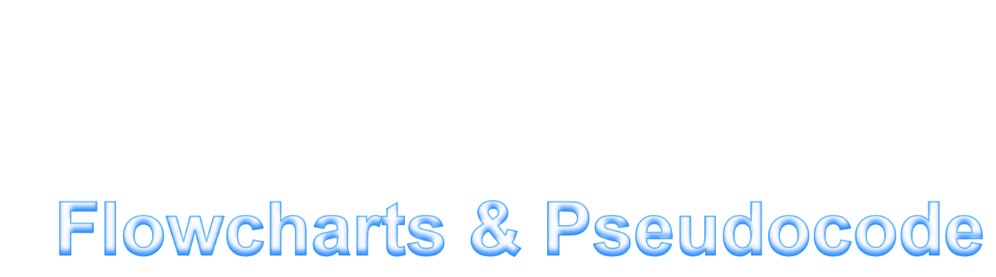


Slide 2
Contents
1
Flowchart revision
2
Pseudocode revision
3
Worked example
4
An exercise
@acdit

Slide 3
What is a flowchart?
A flowchart is a graphical diagram which can be used to represent an algorithm
@acdit

Slide 4
Symbols
Terminal
Decision
Input/Output Operation
Process
@acdit

Slide 5
START
Read in A
B = A*2
Print B
END
@acdit

Slide 6
What is pseudocode?
Pseudocode is a readable description of what an algorithm should do, which can be implemented in any language
@acdit

Slide 7
Structured English and Pseudocode
Structured English
Pseudocode
PROGRAM PrintNumber:
Read in a number and print it out.
END.
PROGRAM PrintNumber:
Read A
Print A
END.
@acdit

Slide 8
An exercise ….
Write the following algorithm in both pseudo code and a flowchart:
  Print the sum of the following numbers -1…5
@acdit

Slide 9
START
Total = 0
A = 1
A = A + 1
Is A==6?
No
Total = Total + A;
Yes
Print Total
END
@acdit

Slide 10
Structured English and Pseudocode
Structured English
Pseudocode
PROGRAM PrintSum1to5:
Keep adding the numbers from 1 to 5.
END.
PROGRAM PrintSum1to5:
Total = 0
A = 1
WHILE (A NOT EQUAL TO 6) DO
Total = Total + A
A = A + 1
ENDWHILE
Print Total
END.
@acdit

Slide 11
More exercises ….
Alter the previous algorithm so that it calculates the sum of the numbers 1 to 100 but include only multiples of three or five in the sum e.g., 3, 5, 6, 9, 10.
Given a list of positive numbers return the largest number in the list.
@acdit

Slide 12
A group exercise ….
In groups of 4, take a case study, draw a flowchart, and matching pseudocode
Assign yourself roles (as stated on the handout)
Take a photo of flowchart & pseudocode and upload to Twitter (one per group)
@acdit

Slide 13
Thank You !

